Slide 1
Crux Lecture -17
Data Structures -7
Priority Queues, Heaps
Notes:
File Handling
Linked list code

Slide 2
Data Structures so far
Linked Lists
Stacks and Queues
Trees(Generic + Binary)
BST
Maps
Notes:
Talk about circular linked list

Slide 3
How to find min/max out of some elements?
Notes:
Make them create one file from next time

Slide 4
Implement using unsorted List
Min
RemoveMin
Insert
Notes:
Talk about circular linked list

Slide 5
Implement using sorted List
Min
RemoveMin
Insert
Notes:
Talk about circular linked list

Slide 6
Any other options?
Notes:
Trade off between having one efficient and one non efficient method…lets have a logn method for both

Slide 7
Heaps
Notes:
Trade off between having one efficient and one non efficient method…lets have a logn method for both

Slide 8
Heap Data Structure
Binary Tree
Heap Order Property
Complete Binary Tree Property
Notes:
Talk about circular linked list

Slide 9
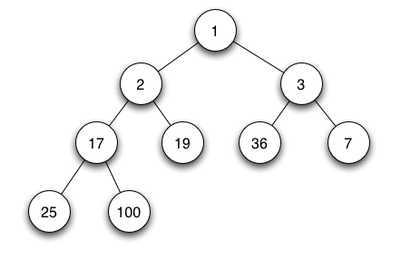
Notes:
Make them create one file from next time

Slide 10
What is the height of a complete binary tree?
Notes:
Trade off between having one efficient and one non efficient method…lets have a logn method for both

Slide 11
Complete Binary Tree
Add
Remove
Notes:
Talk about circular linked list

Slide 12
How to implement Heap using CBT?
Min
Insertion
removeMin
Notes:
Talk about circular linked list

Slide 13
Building a Heap in O(n)
Notes:
Sigma x^j = 1/1-x
Differentiate

Slide 14

Thank You!
Rishab Kapoor
Rishab.Kapoor.29@gmail.com

